Slide 1
AMS 603 Risk Measures for Finance and Data Analysis
Final Presentation, April 26 2022
Uday Talwar

Slide 2
Adding Alpha while Managing Risk

Slide 3
Overview
We use portfolio optimization, a mathematical framework to select optimal portfolios subject to a certain objective, to optimize the risk-return trade-off inherent in investment portfolios.
Proposed methods are back-tested in Python using open-source packages.
Simplifying assumptions such as no transaction costs and no minimum transaction lots are made for the purpose of calculation.
Possible future work and applications.

Slide 4
Investment Portfolios
An investment portfolio is a collection of assets and may include investments in different asset classes such as equity, fixed income and alternative assets (e.g. Cryptocurrency).
A portfolio provides an investor with (often measured) exposure to varying asset classes with different risk-return profiles.
Diversified portfolios should, in theory, limit downside risks to an investor’s asset base.
Portfolio building is common-place at all corpus sizes – from individual investors to Norway’s Sovereign Wealth Fund (~$1.4 Trillion).

Slide 5
Portfolio Optimization
Economist Harry Markowitz introduced the mean-variance framework in his 1952 essay titled “Portfolio Selection”.
The classical Markowitz model uses variance as the measure of risk and is a quadratic programming problem.
Several other risk measures have been considered since then.

Slide 6
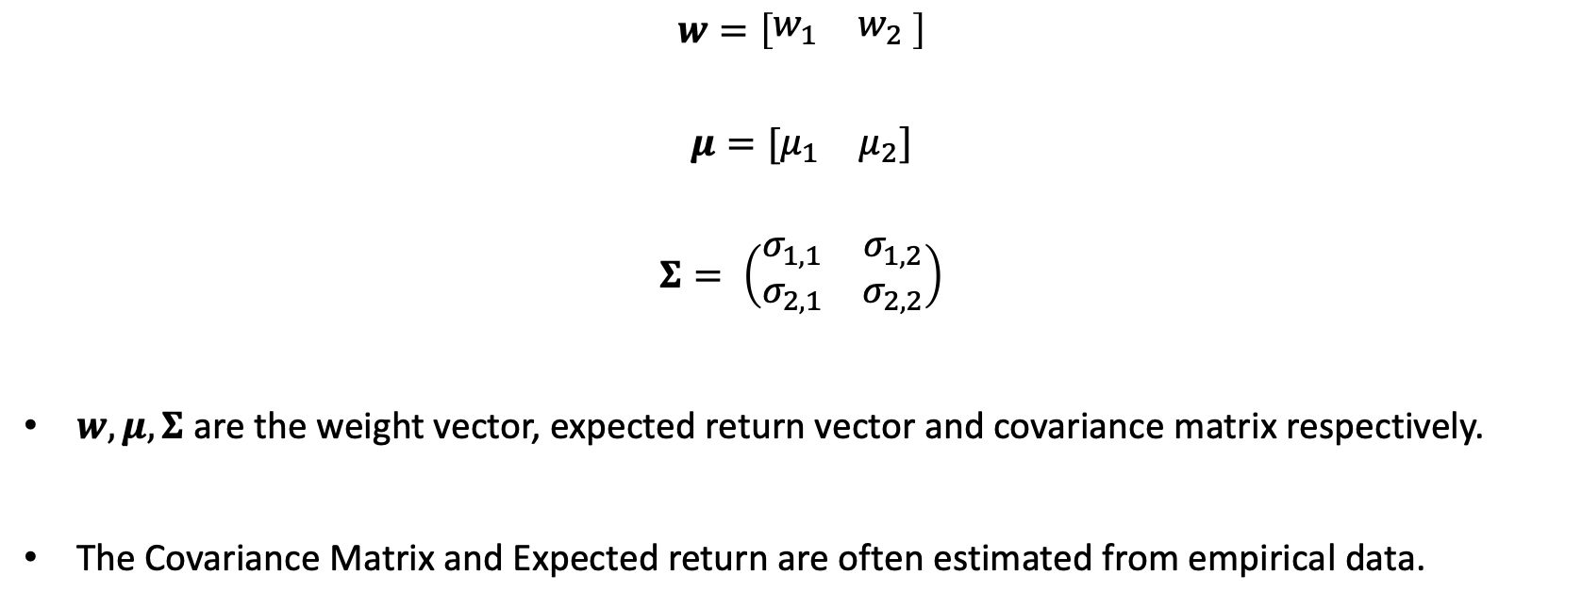
Mean-Variance framework set up (2-asset example)
$$w=\left[\begin{matrix}w_{1} & w_{2}\end{matrix} \right]$$
$$μ=[\begin{matrix}μ_{1} & μ_{2}]\end{matrix}$$
$$Σ= \left(\begin{matrix}σ_{1,1} & σ_{1,2} \\ σ_{2,1} & σ_{2,2}\end{matrix}\right)$$
$w, μ, Σ$ are the weight vector, expected return vector and covariance matrix respectively.
The Covariance Matrix and Expected return are often estimated from empirical data.

Slide 7
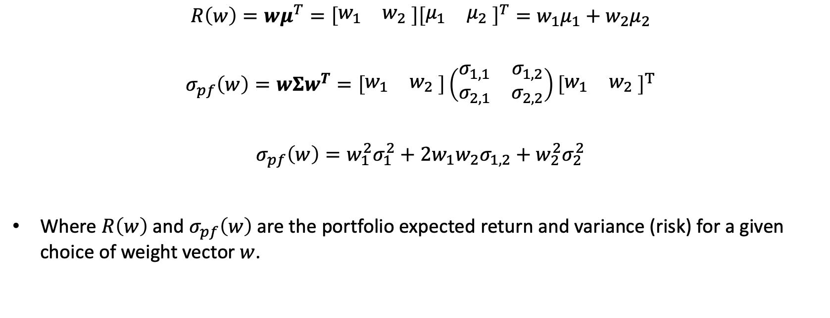
Mean-Variance framework set up (2-asset example)
$$R\left(w\right)=wμ^{T}=\left[\begin{matrix}w_{1} & w_{2}\end{matrix} \right]{\left[\begin{matrix}μ_{1} & μ_{2}\end{matrix} \right]}^{T}=w_{1}μ_{1}+w_{2}μ_{2}$$
$$σ_{pf}\left(w\right)=wΣw^{T}=\left[\begin{matrix}w_{1} & w_{2}\end{matrix} \right]\left(\begin{matrix}σ_{1,1} & σ_{1,2} \\ σ_{2,1} & σ_{2,2}\end{matrix}\right){\left[\begin{matrix}w_{1} & w_{2}\end{matrix} \right]}^{T}$$
$$σ_{pf}\left(w\right)=w_{1}^{2}σ_{1}^{2}+2w_{1}w_{2}σ_{1,2}+w_{2}^{2}σ_{2}^{2}$$
Where $R\left(w\right)$ and $σ_{pf}\left(w\right)$ are the portfolio expected return and variance (risk) for a given choice of weight vector $w$.

Slide 8
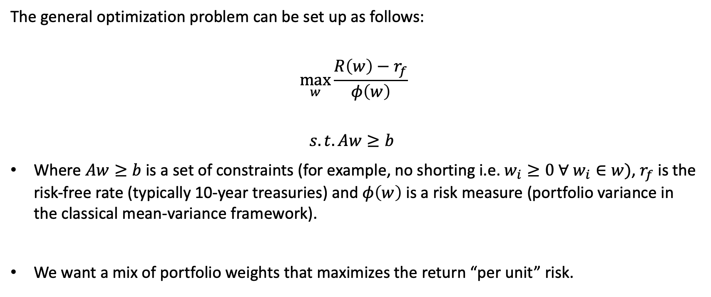
Optimizing the risk-return trade-off
The general optimization problem can be set up as follows:
$$\max_{w}{\frac{R\left(w\right)−r_{f}}{φ\left(w\right)}}$$
$$s.t. Aw≥b$$
Where $Aw≥b$is a set of constraints (for example, no shorting i.e. $w_{i}≥0 ∀ w_{i}∈w)$, $r_{f}$ is the risk-free rate (typically 10-year treasuries) and $φ\left(w\right)$ is a risk measure (portfolio variance in the classical mean-variance framework).
We want a mix of portfolio weights that maximizes the return “per unit” risk.

Slide 9
Alternative measures of risk
Since Markowitz’s 1952 essay, many methods to measure risk have been proposed and there is now a family of mean-risk models. Some examples include:
Mean Absolute Deviation [1]
Semi Standard Deviation [2]
First Lower Partial Moment (Omega Ratio) [3]
Second Lower Partial Moment (Sortino Ratio) [3]
Conditional Value at Risk [4]

Slide 10
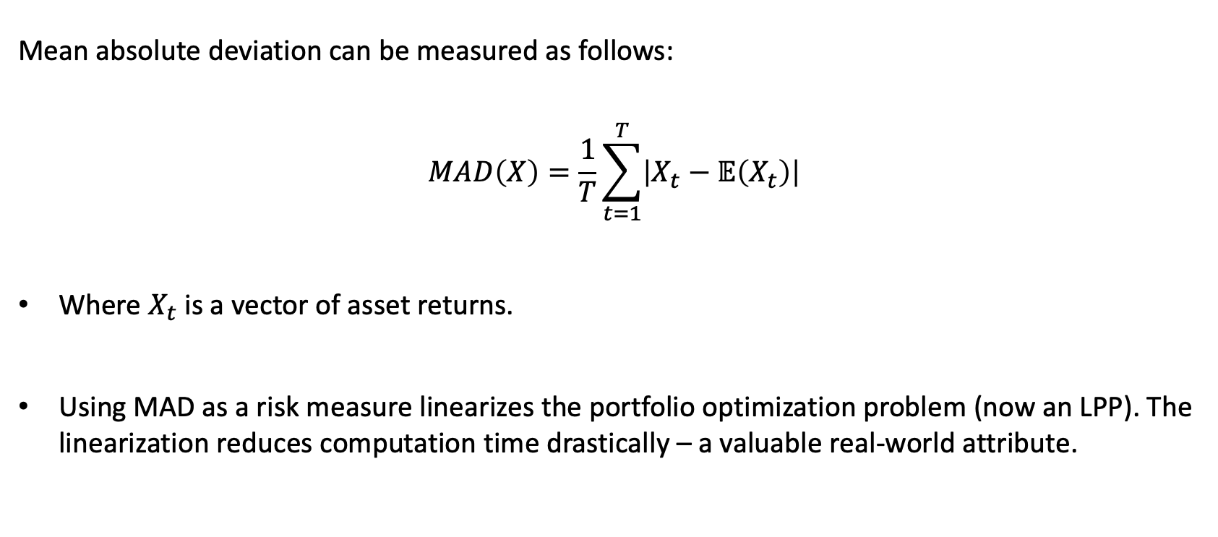
Our approach – using Mean Absolute Deviation or MAD
Mean absolute deviation can be measured as follows:
$$MAD\left(X\right)=\frac{1}{T}\sum_{t=1}^{T}{\left|X_{t}−𝔼\left(X_{t}\right)\right|}$$
Where $X_{t}$ is a vector of asset returns.
Using MAD as a risk measure linearizes the portfolio optimization problem (now an LPP). The linearization reduces computation time drastically – a valuable real-world attribute.

Slide 11
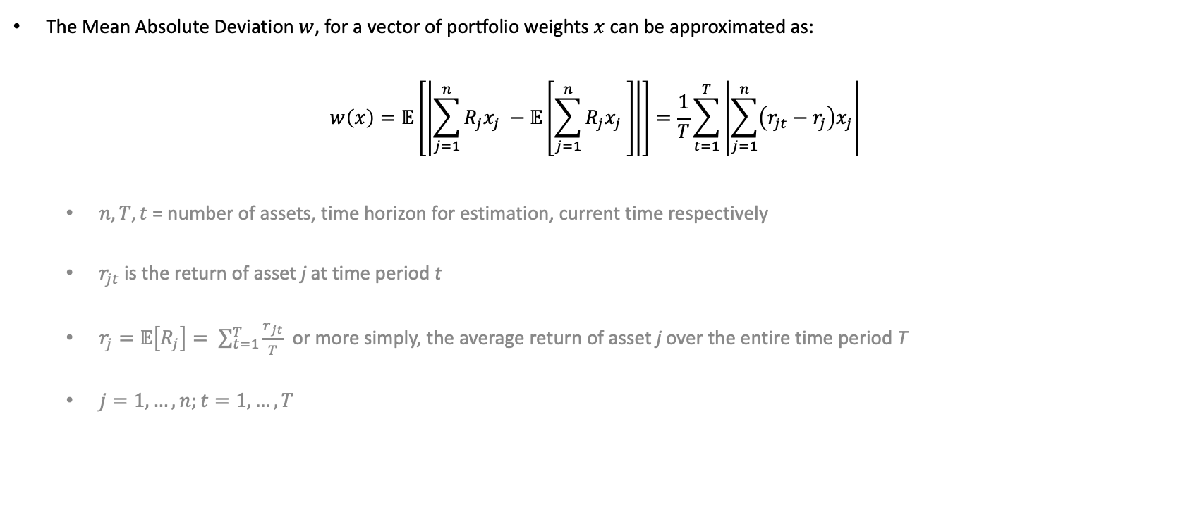
Optimization with MAD (from Konno et al. 1991 [1])
The Mean Absolute Deviation $w$, for a vector of portfolio weights $x$ can be approximated as:
$$w\left(x\right)=𝔼\left[\left|\sum_{j=1}^{n}{R_{j}x_{j}} −𝔼\left[\sum_{j=1}^{n}{R_{j}x_{j} }\right]\right|\right]=\frac{1}{T}\sum_{t=1}^{T}{\left|\sum_{j=1}^{n}{\left(r_{jt}−r_{j}\right)x_{j}}\right|}$$
$n, T, t$ = number of assets, time horizon for estimation, current time respectively
$r_{jt}$ is the return of asset j at time period t
$r_{j}=𝔼\left[R_{j}\right]= \sum_{t=1}^{T}{\frac{r_{jt}}{T}}$ or more simply, the average return of asset j over the entire time period T
$j=1, …,n;t=1, …, T$

Slide 12
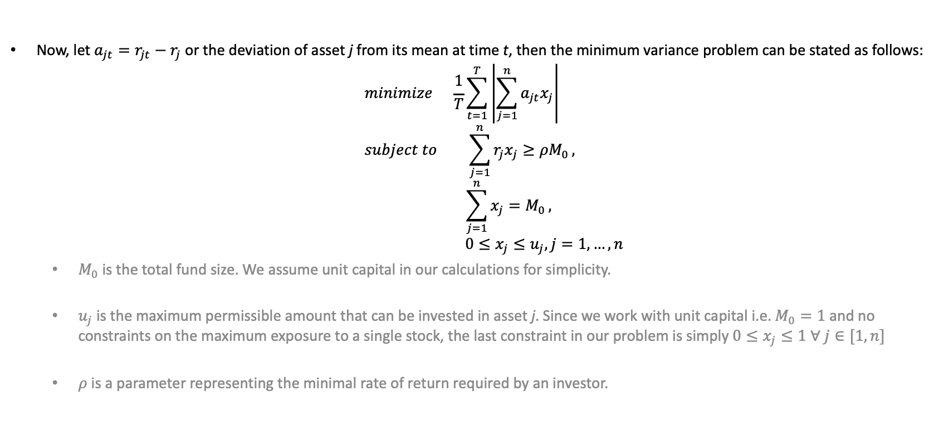
Optimization with MAD (from Konno et al. 1991 [1])
Now, let $a_{jt}=r_{jt}−r_{j}$ or the deviation of asset j from its mean at time t, then the minimum variance problem can be stated as follows:
$$minimize \frac{1}{T}\sum_{t=1}^{T}{\left|\sum_{j=1}^{n}{a_{jt}x_{j}}\right|} \\ subject to \sum_{j=1}^{n}{r_{j}x_{j}≥ρM_{0}}, \\ \sum_{j=1}^{n}{x_{j}=M_{0}},$$
$$0≤x_{j}≤u_{j}, j=1, …,n$$
$M_{0}$ is the total fund size. We assume unit capital in our calculations for simplicity.
$u_{j}$ is the maximum permissible amount that can be invested in asset j. Since we work with unit capital i.e. $M_{0}=1$ and no constraints on the maximum exposure to a single stock, the last constraint in our problem is simply $0≤x_{j}≤1 ∀ j∈[1, n]$
$ρ$ is a parameter representing the minimal rate of return required by an investor.

Slide 13
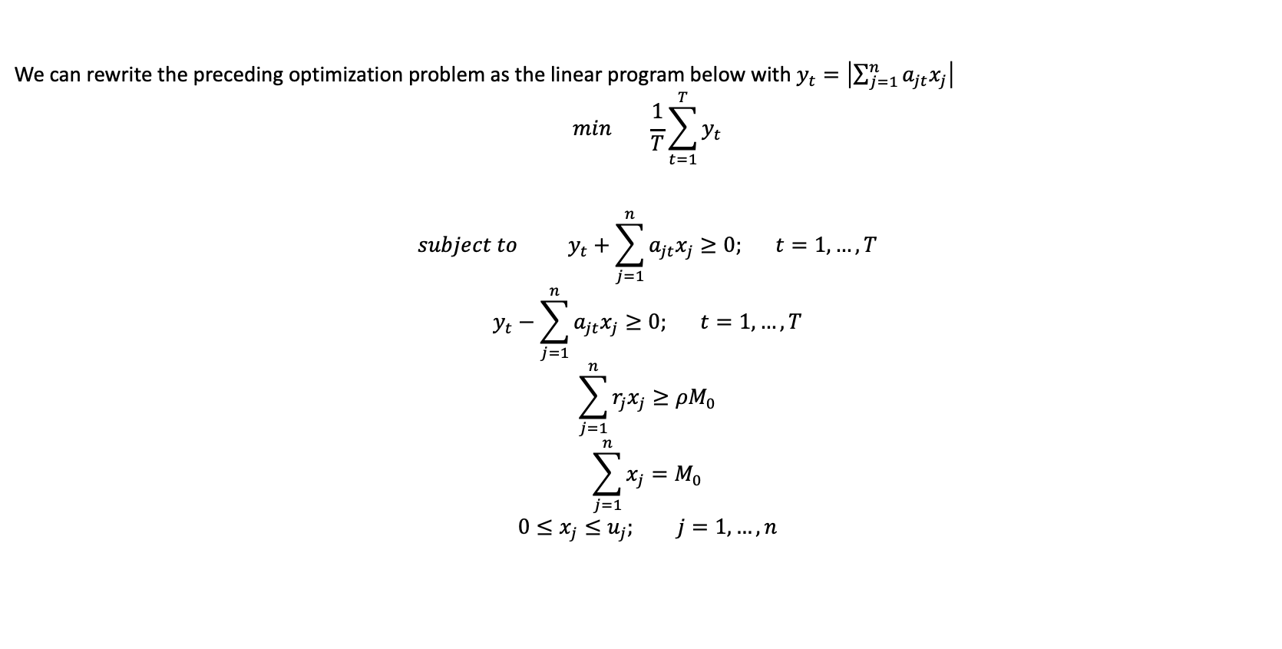
Optimization with MAD (from Konno et al. 1991 [1])
We can rewrite the preceding optimization problem as the linear program below with $y_{t}=\left|\sum_{j=1}^{n}{a_{jt}x_{j}}\right|$
$$\min{ \frac{1}{T}\sum_{t=1}^{T}{y_{t}}}$$
$$subject to y_{t}+\sum_{j=1}^{n}{a_{jt}x_{j}≥0; t=1, …, T} \\ y_{t}−\sum_{j=1}^{n}{a_{jt}x_{j}≥0; t=1, …, T} \\ \sum_{j=1}^{n}{r_{j}x_{j}≥ρM_{0}} \\ \sum_{j=1}^{n}{x_{j}=M_{0}} \\ 0≤x_{j}≤u_{j}; j=1,…, n$$

Slide 14
Calculating Optimized Portfolio Weights
We maximize the risk-adjusted return. Data from January 1 2000 till January 1 2022. Risk-free rate taken to be 0%.
Apply the MAD model to 250 days of asset returns (277 publicly traded stocks from the SP500).
Move the window by 1 day at a time (daily-rolling) for a total of 5285 or ~21 years of optimized daily portfolio weights.
The MAD model takes ~40 minutes to calculate 21 years of optimized daily weights while mean-variance takes > 2 hours. Linearity speeds up computation significantly.

Slide 15
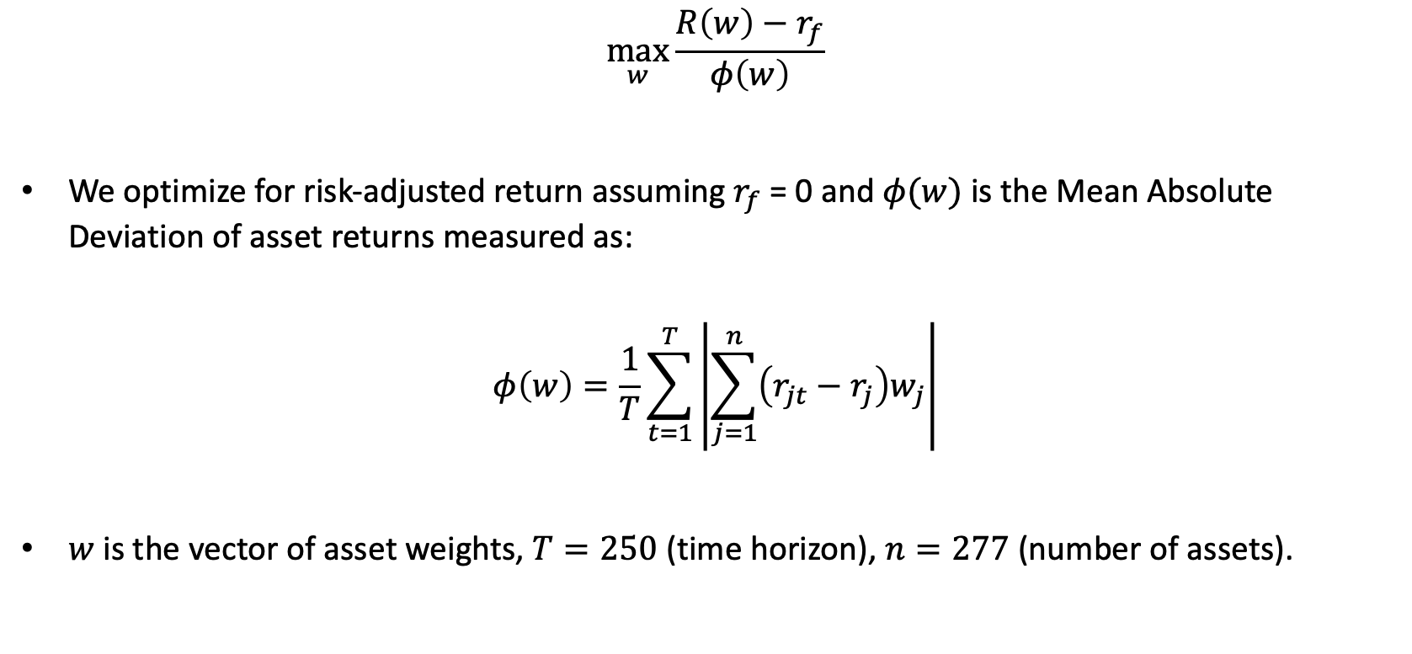
Optimization set up
$$\max_{w}{\frac{R\left(w\right)−r_{f}}{φ\left(w\right)}}$$
We optimize for risk-adjusted return assuming $r_{f}$ = 0 and $φ(w)$ is the Mean Absolute Deviation of asset returns measured as:
$$φ\left(w\right)=\frac{1}{T}\sum_{t=1}^{T}{\left|\sum_{j=1}^{n}{\left(r_{jt}−r_{j}\right)w_{j}}\right|}$$
$w$ is the vector of asset weights, $T=250$ (time horizon), $n=277$ (number of assets).

Slide 16
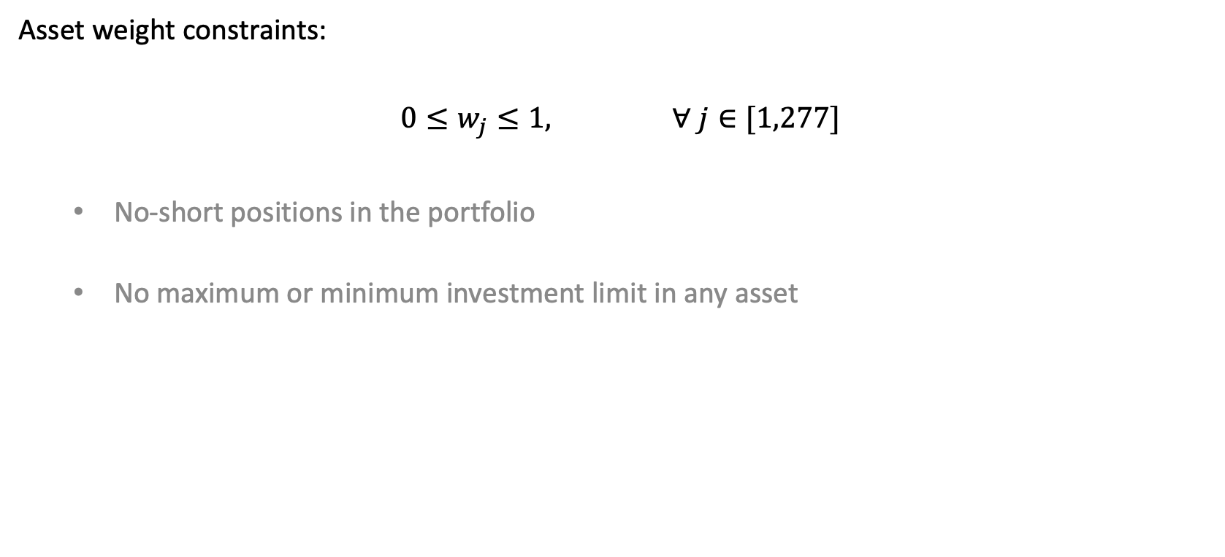
Optimization set up
Asset weight constraints:
$$0≤w_{j}≤1, ∀ j∈[1,277]$$
No-short positions in the portfolio
No maximum or minimum investment limit in any asset

Slide 17
Sample portfolios, efficient frontiers, efficient frontier asset structures

Slide 18
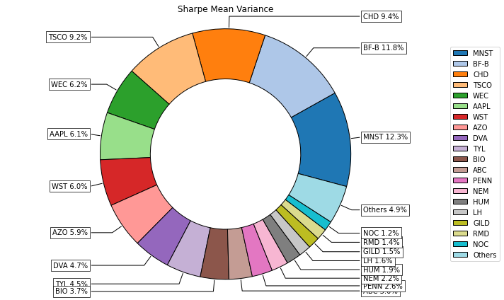
Portfolio Composition (mean-variance)
Asset | Asset Weights (>1%)
MNST | 12.28%
BF-B | 11.76%
CHD | 9.38%
TSCO | 9.21%
WEC | 6.17%
AAPL | 6.09%
WST | 5.99%
AZO | 5.89%
DVA | 4.72%
TYL | 4.45%
BIO | 3.66%
ABC | 3.01%
PENN | 2.64%
NEM | 2.17%
HUM | 1.89%
LH | 1.58%
GILD | 1.52%
RMD | 1.44%
NOC | 1.22%
Total | 95.06%
Top 5 | 48.80%
Top 15 | 89.29%
Number of assets = 277, Data Points = 5535, Data Period = January 1 2000 to January 2022

Slide 19
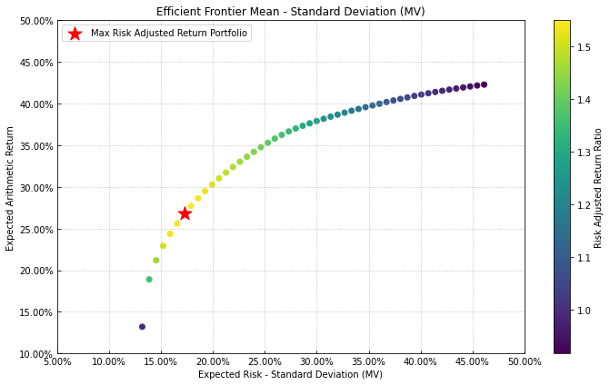

Efficient Frontier ($σ−μ$ space)
Number of assets = 277, Data Points = 5535, Data Period = January 1 2000 to January 2022

Slide 20
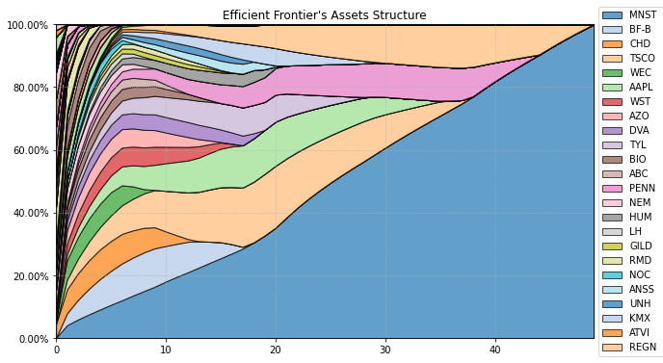

Efficient Frontier Composition ($σ−μ$ )
Number of assets = 277, Data Points = 5535, Data Period = January 1 2000 to January 2022

Slide 21
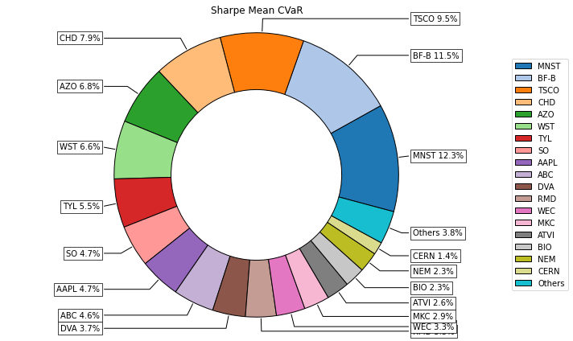
Portfolio Composition (mean-CVaR)
Asset | Asset Weights (>1%)
MNST | 12.26%
BF-B | 11.52%
TSCO | 9.49%
CHD | 7.91%
AZO | 6.82%
WST | 6.62%
TYL | 5.54%
SO | 4.74%
AAPL | 4.66%
ABC | 4.64%
DVA | 3.74%
RMD | 3.49%
WEC | 3.28%
MKC | 2.90%
ATVI | 2.58%
BIO | 2.31%
NEM | 2.29%
CERN | 1.44%
LH | 1.32%
KMX | 1.27%
REGN | 1.07%
Total | 99.91%
Top 5 | 48.00%
Top 15 | 90.19%
Number of assets = 277, Data Points = 5535, Data Period = January 1 2000 to January 2022

Slide 22
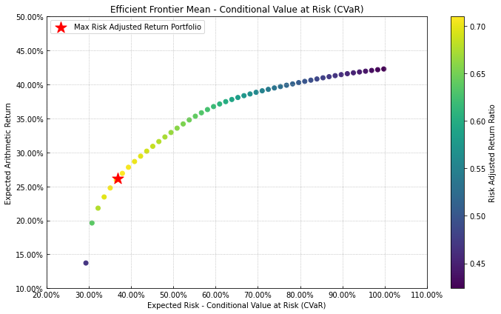

Efficient Frontier ($CVaR−μ$ space)
Number of assets = 277, Data Points = 5535, Data Period = January 1 2000 to January 2022

Slide 23
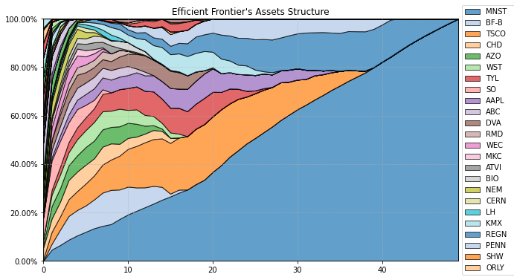

Efficient Frontier Composition ($CVaR−μ$ )
Number of assets = 277, Data Points = 5535, Data Period = January 1 2000 to January 2022

Slide 24
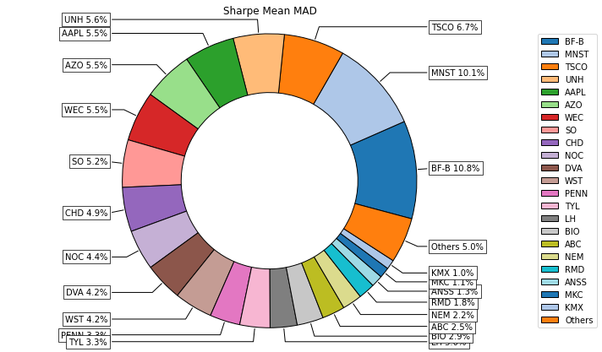
Portfolio Composition (mean-MAD)
Asset | Asset Weights (>1%)
BF-B | 10.77%
MNST | 10.12%
TSCO | 6.67%
UNH | 5.60%
AAPL | 5.53%
AZO | 5.50%
WEC | 5.49%
SO | 5.21%
CHD | 4.87%
NOC | 4.44%
DVA | 4.20%
WST | 4.20%
PENN | 3.32%
TYL | 3.31%
LH | 2.96%
BIO | 2.90%
ABC | 2.50%
NEM | 2.16%
RMD | 1.81%
ANSS | 1.29%
MKC | 1.15%
KMX | 1.03%
VTR | 1.01%
Total | 96.03%
Top 5 | 38.68%
Top 15 | 82.19%
Number of assets = 277, Data Points = 5535, Data Period = January 1 2000 to January 2022

Slide 25
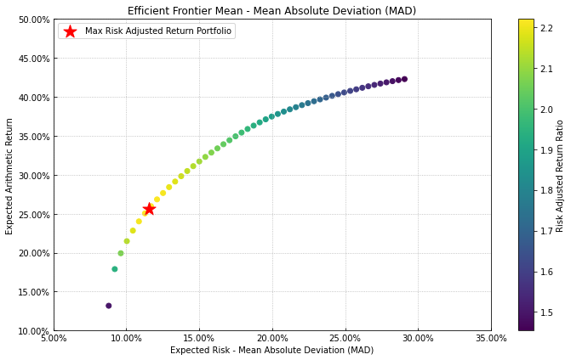

Efficient Frontier ($MAD−μ$ space)
Number of assets = 277, Data Points = 5535, Data Period = January 1 2000 to January 2022

Slide 26
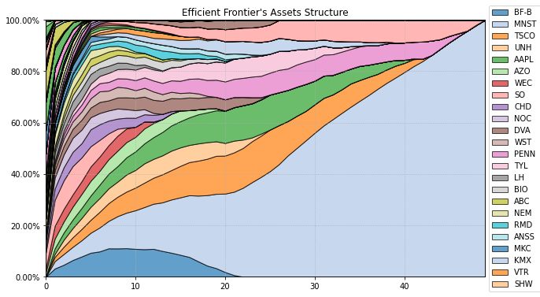

Efficient Frontier Composition ($MAD−μ$)
Number of assets = 277, Data Points = 5535, Data Period = January 1 2000 to January 2022

Slide 27
Empirical results (MAD Model)

Slide 28
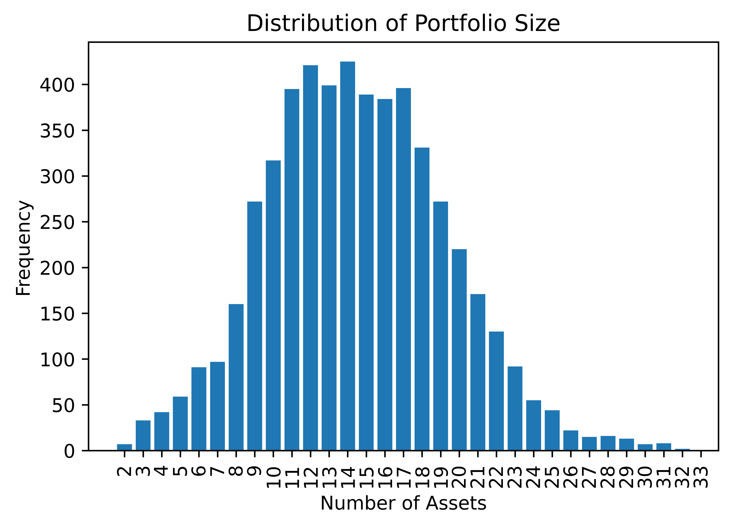
Overview of optimized portfolio weights
Metric | Portfolio Size*
Mean | 14.5
Standard Deviation | 4.8
Minimum | 2
25th Percentile | 11
50th Percentile | 14
75th Percentile | 18
Maximum | 33
Total Portfolios = 5285, Size/Weight = number of assets with portfolio weight > 1%

Slide 29
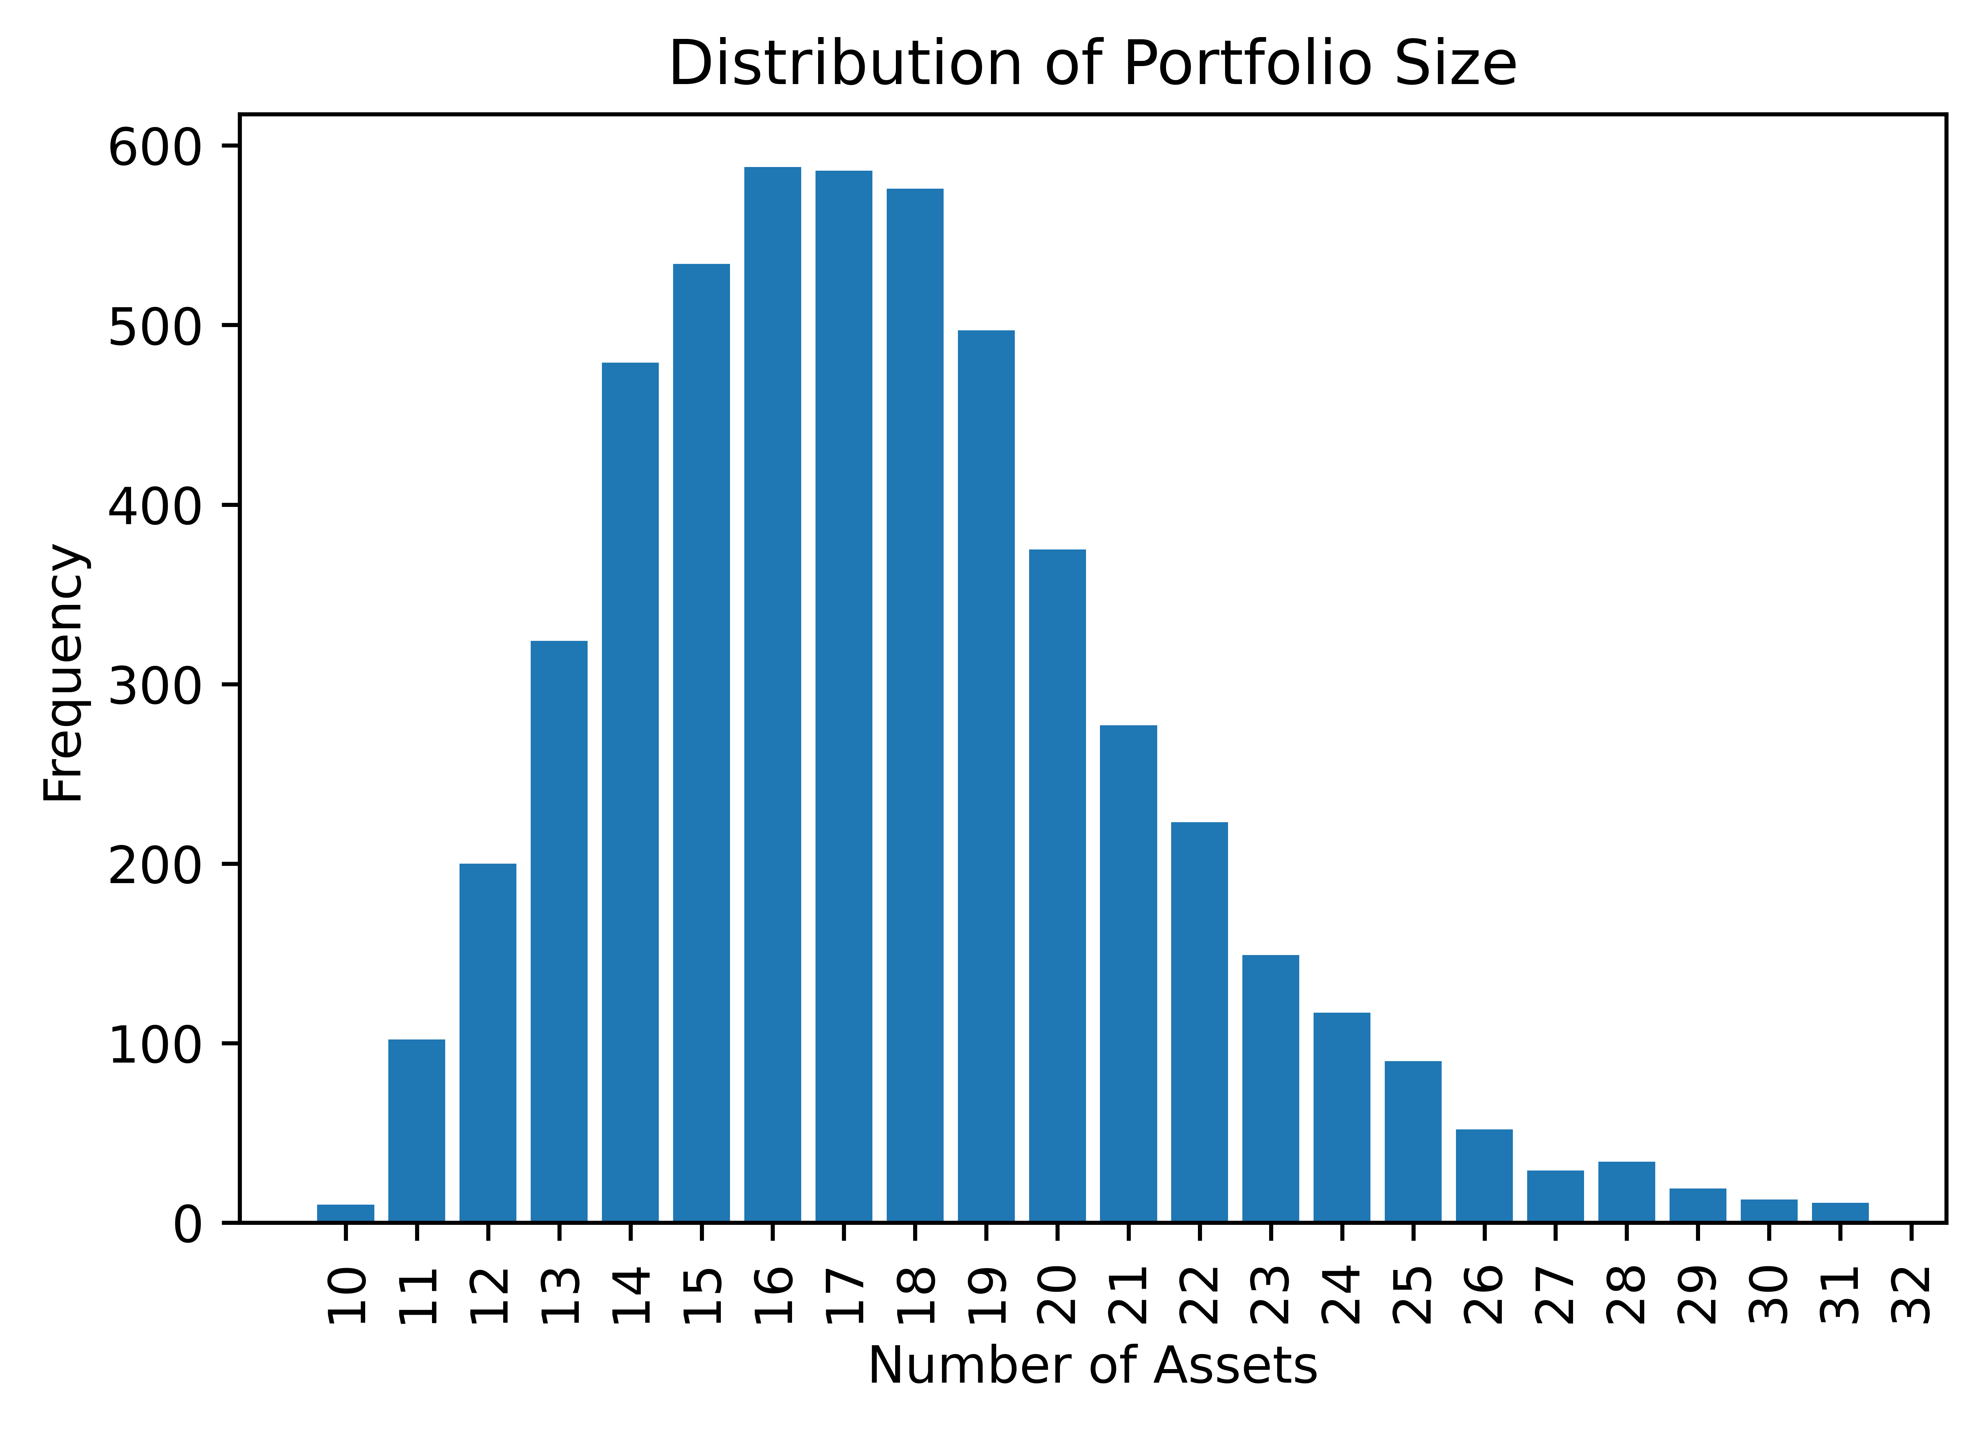
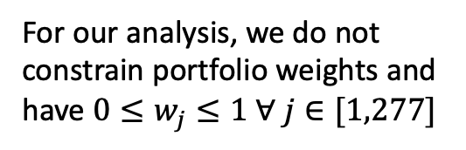
How an upper bound on Asset Weights alters the portfolio size distribution
Metric | Portfolio Size*
Mean | 17.6
Standard Deviation | 3.7
Minimum | 10
25th Percentile | 15
50th Percentile | 17
75th Percentile | 20
Maximum | 32
For our analysis, we do not constrain portfolio weights and have $0≤w_{j}≤1 ∀ j∈[1,277]$
Total Portfolios = 5285, Size/Weight = number of assets with portfolio weight > 1%

Slide 30
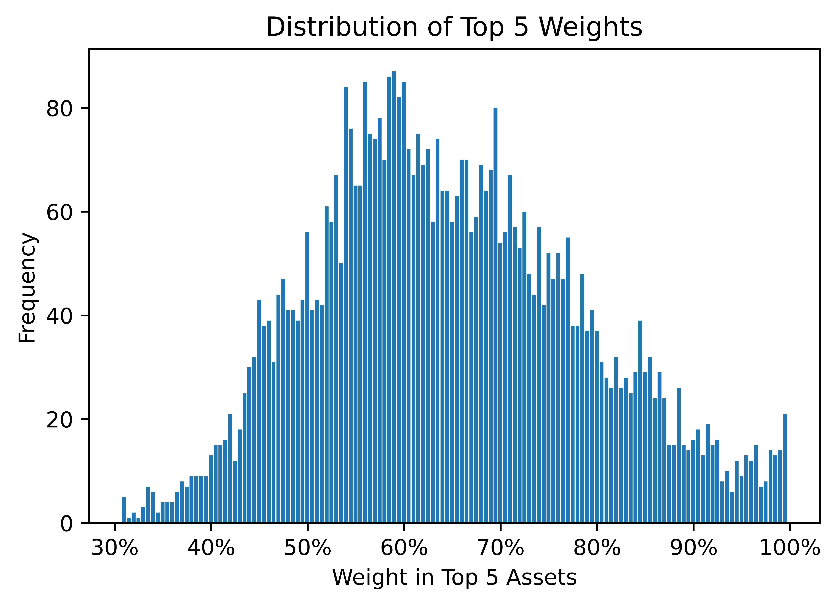
Overview of optimized portfolio weights
Metric | Weight (%, Top 5)*
Mean | 65.5%
Standard Deviation | 14.5%
Minimum | 30.7%
25th Percentile | 55.1%
50th Percentile | 63.9%
75th Percentile | 75.0%
Maximum | 100.0%
Total Portfolios = 5285, Size/Weight = number of assets with portfolio weight > 1%

Slide 31
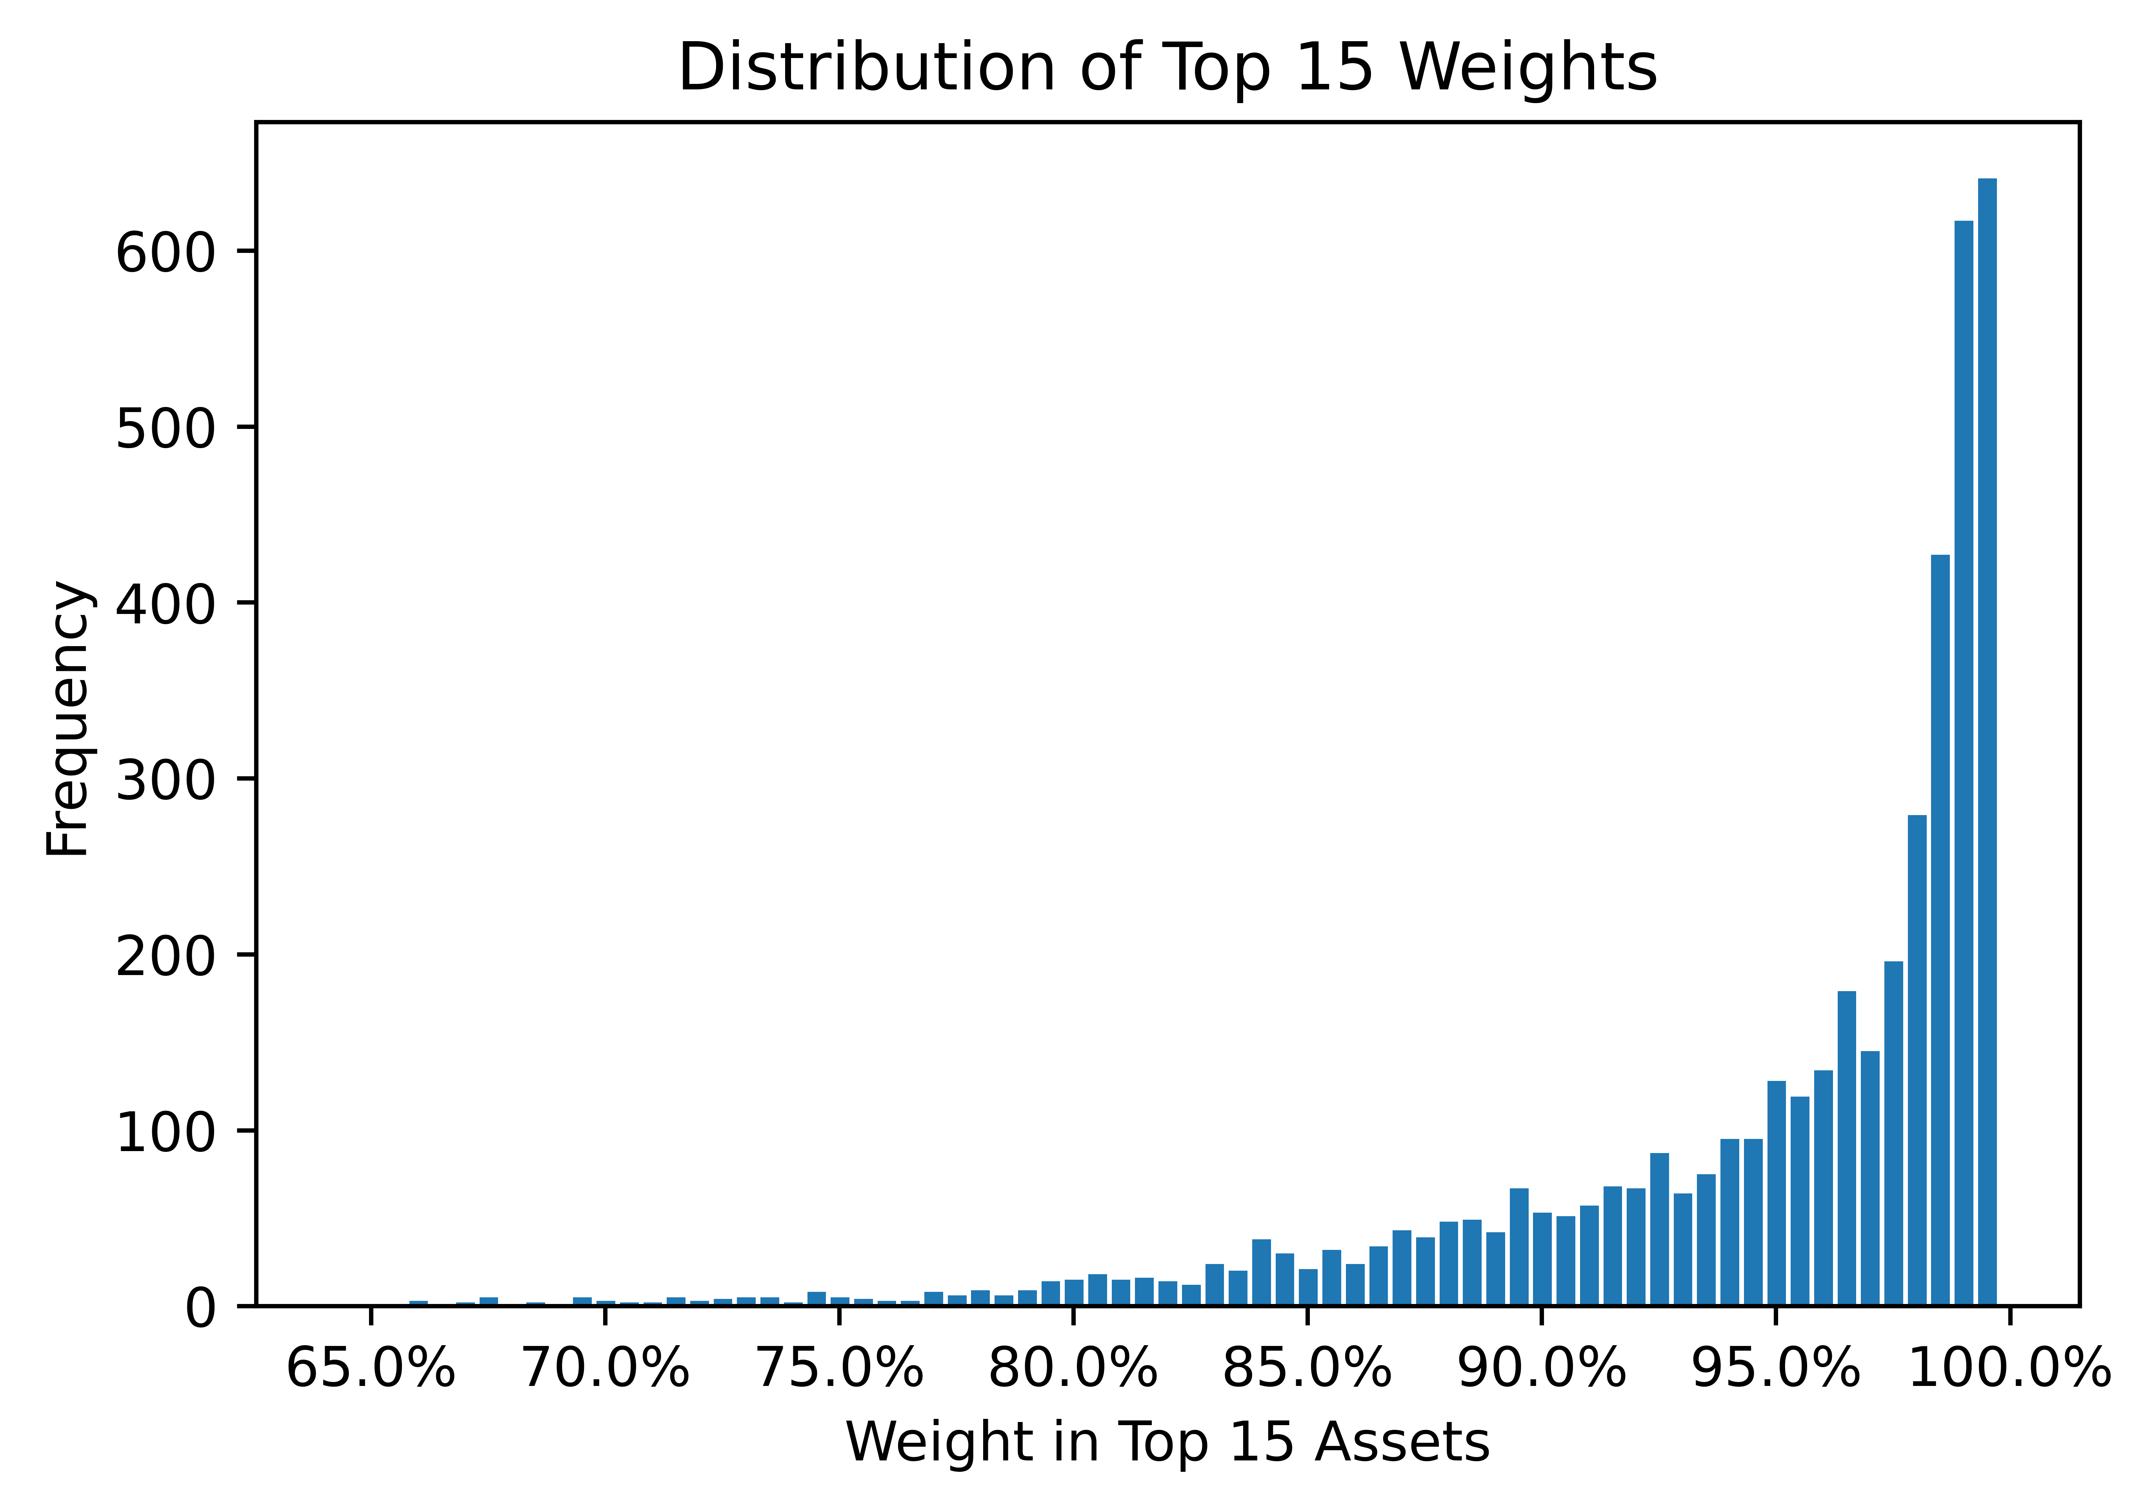
Overview of optimized portfolio weights
Metric | Weight (%, Top 15)*
Mean | 95.8%
Standard Deviation | 5.7%
Minimum | 64.3%
25th Percentile | 94.1%
50th Percentile | 98.3%
75th Percentile | 99.5%
Maximum | 100.0%
Total Portfolios = 5285, Size/Weight = number of assets with portfolio weight > 1%

Slide 32
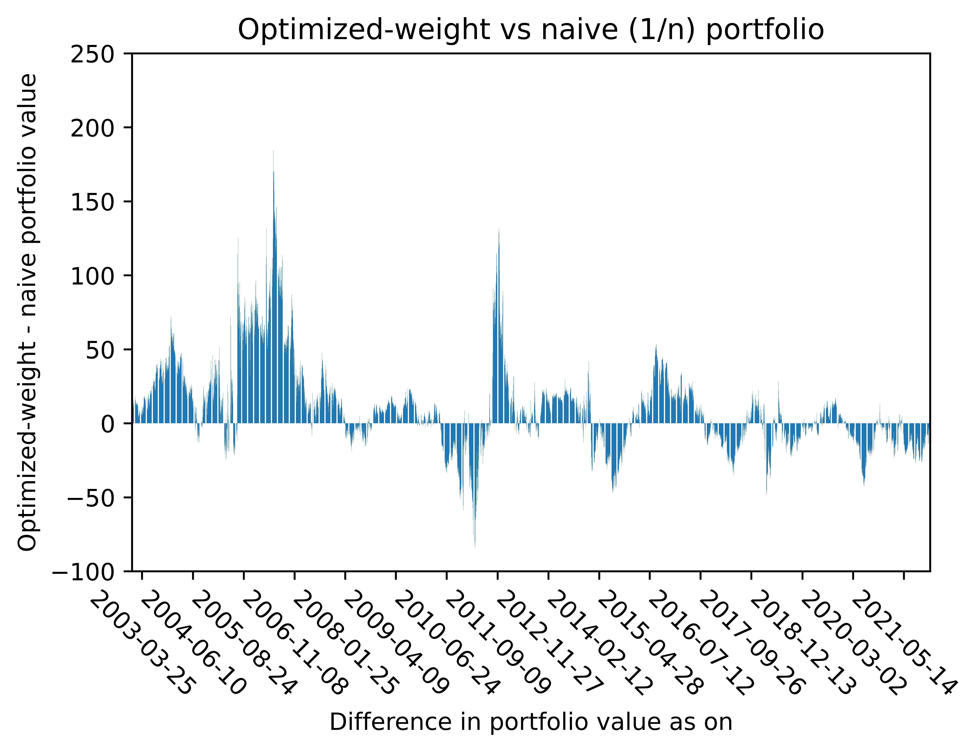
Back-test; Optimized vs naïve (1/n) portfolio
Metric (1 year) | Optimal Weight Portfolio | Naïve Portfolio
Average Portfolio Return | 15.16% | 12.25%
Average Portfolio SD | 9.14% | 8.15%
Minimum Return | -17.01% | -25.45%
25th Percentile Return | 7.01% | 7.33%
Median Return | 15.00% | 13.56%
75th Percentile Return | 22.47% | 18.06%
Maximum Return | 70.97% | 37.58%
Metric (2 years, annualized) | Optimal Weight Portfolio | Naïve Portfolio
Average Portfolio Return | 9.53% | 7.77%
Average Portfolio SD | 6.96% | 5.91%
Minimum Return | -19.21% | -23.49%
25th Percentile Return | 4.59% | 4.88%
Median Return | 9.79% | 8.77%
75th Percentile Return | 14.54% | 11.99%
Maximum Return | 50.18% | 20.00%
Holding period = 500 trading days, Total number of portfolio return series generated = 4785
Data from Dec 28 2000 to Dec 29 2021

Slide 33
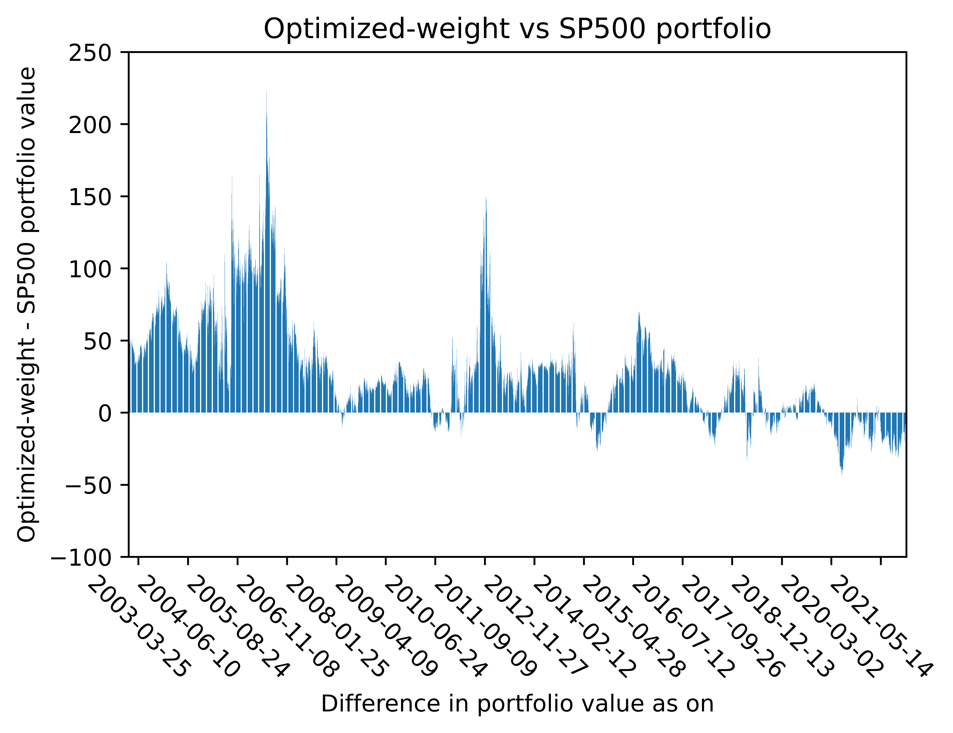
Back-test; Optimized vs SP500 portfolio
Metric (1 year) | Optimal Weight Portfolio | SP500
Average Portfolio Return | 15.16% | 6.61%
Average Portfolio SD | 9.14% | 6.15%
Minimum Return | -17.01% | -30.28%
25th Percentile Return | 7.01% | 3.72%
Median Return | 15.00% | 7.68%
75th Percentile Return | 22.47% | 11.42%
Maximum Return | 70.97% | 33.56%
Metric (2 years, annualized) | Optimal Weight Portfolio | SP500
Average Portfolio Return | 9.53% | 4.34%
Average Portfolio SD | 6.96% | 4.41%
Minimum Return | -19.21% | -26.52%
25th Percentile Return | 4.59% | 2.32%
Median Return | 9.79% | 5.08%
75th Percentile Return | 14.54% | 7.64%
Maximum Return | 50.18% | 21.88%
Holding period = 500 trading days, Total number of portfolio return series generated = 4785
Data from Dec 28 2000 to Dec 29 2021

Slide 34
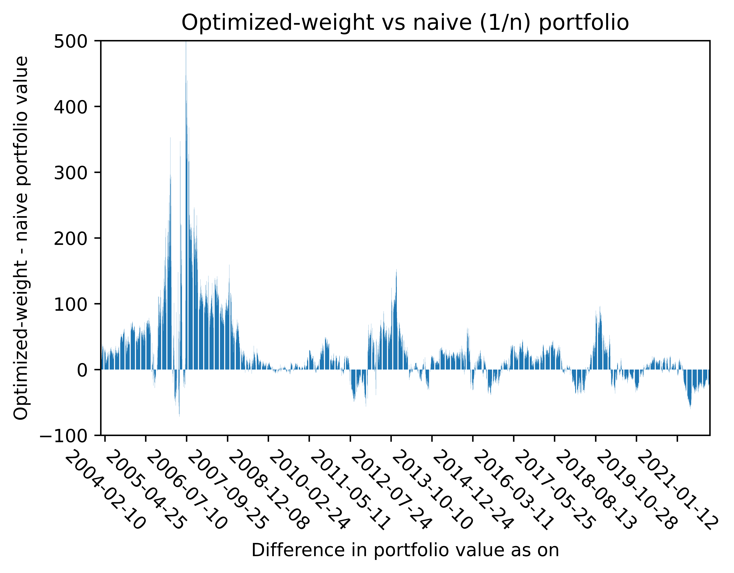
Back-test; Optimized vs naïve (1/n) portfolio
Metric (1 year) | Optimal Weight Portfolio | Naïve Portfolio
Average Portfolio Return | 18.28% | 13.52%
Average Portfolio SD | 12.68% | 10.07%
Minimum Return | -12.88% | -12.13%
25th Percentile Return | 10.95% | 10.36%
Median Return | 16.57% | 14.57%
75th Percentile Return | 23.96% | 19.01%
Maximum Return | 93.82% | 28.39%
Metric (2 years, annualized) | Optimal Weight Portfolio | Naïve Portfolio
Average Portfolio Return | 14.04% | 10.40%
Average Portfolio SD | 10.14% | 8.06%
Minimum Return | -15.67% | -16.15%
25th Percentile Return | 8.38% | 7.43%
Median Return | 13.35% | 11.71%
75th Percentile Return | 18.78% | 15.05%
Maximum Return | 77.85% | 20.97%
Holding period = 750 trading days, Total number of portfolio return series generated = 4535
Data from Dec 28 2000 to Dec 29 2021

Slide 35
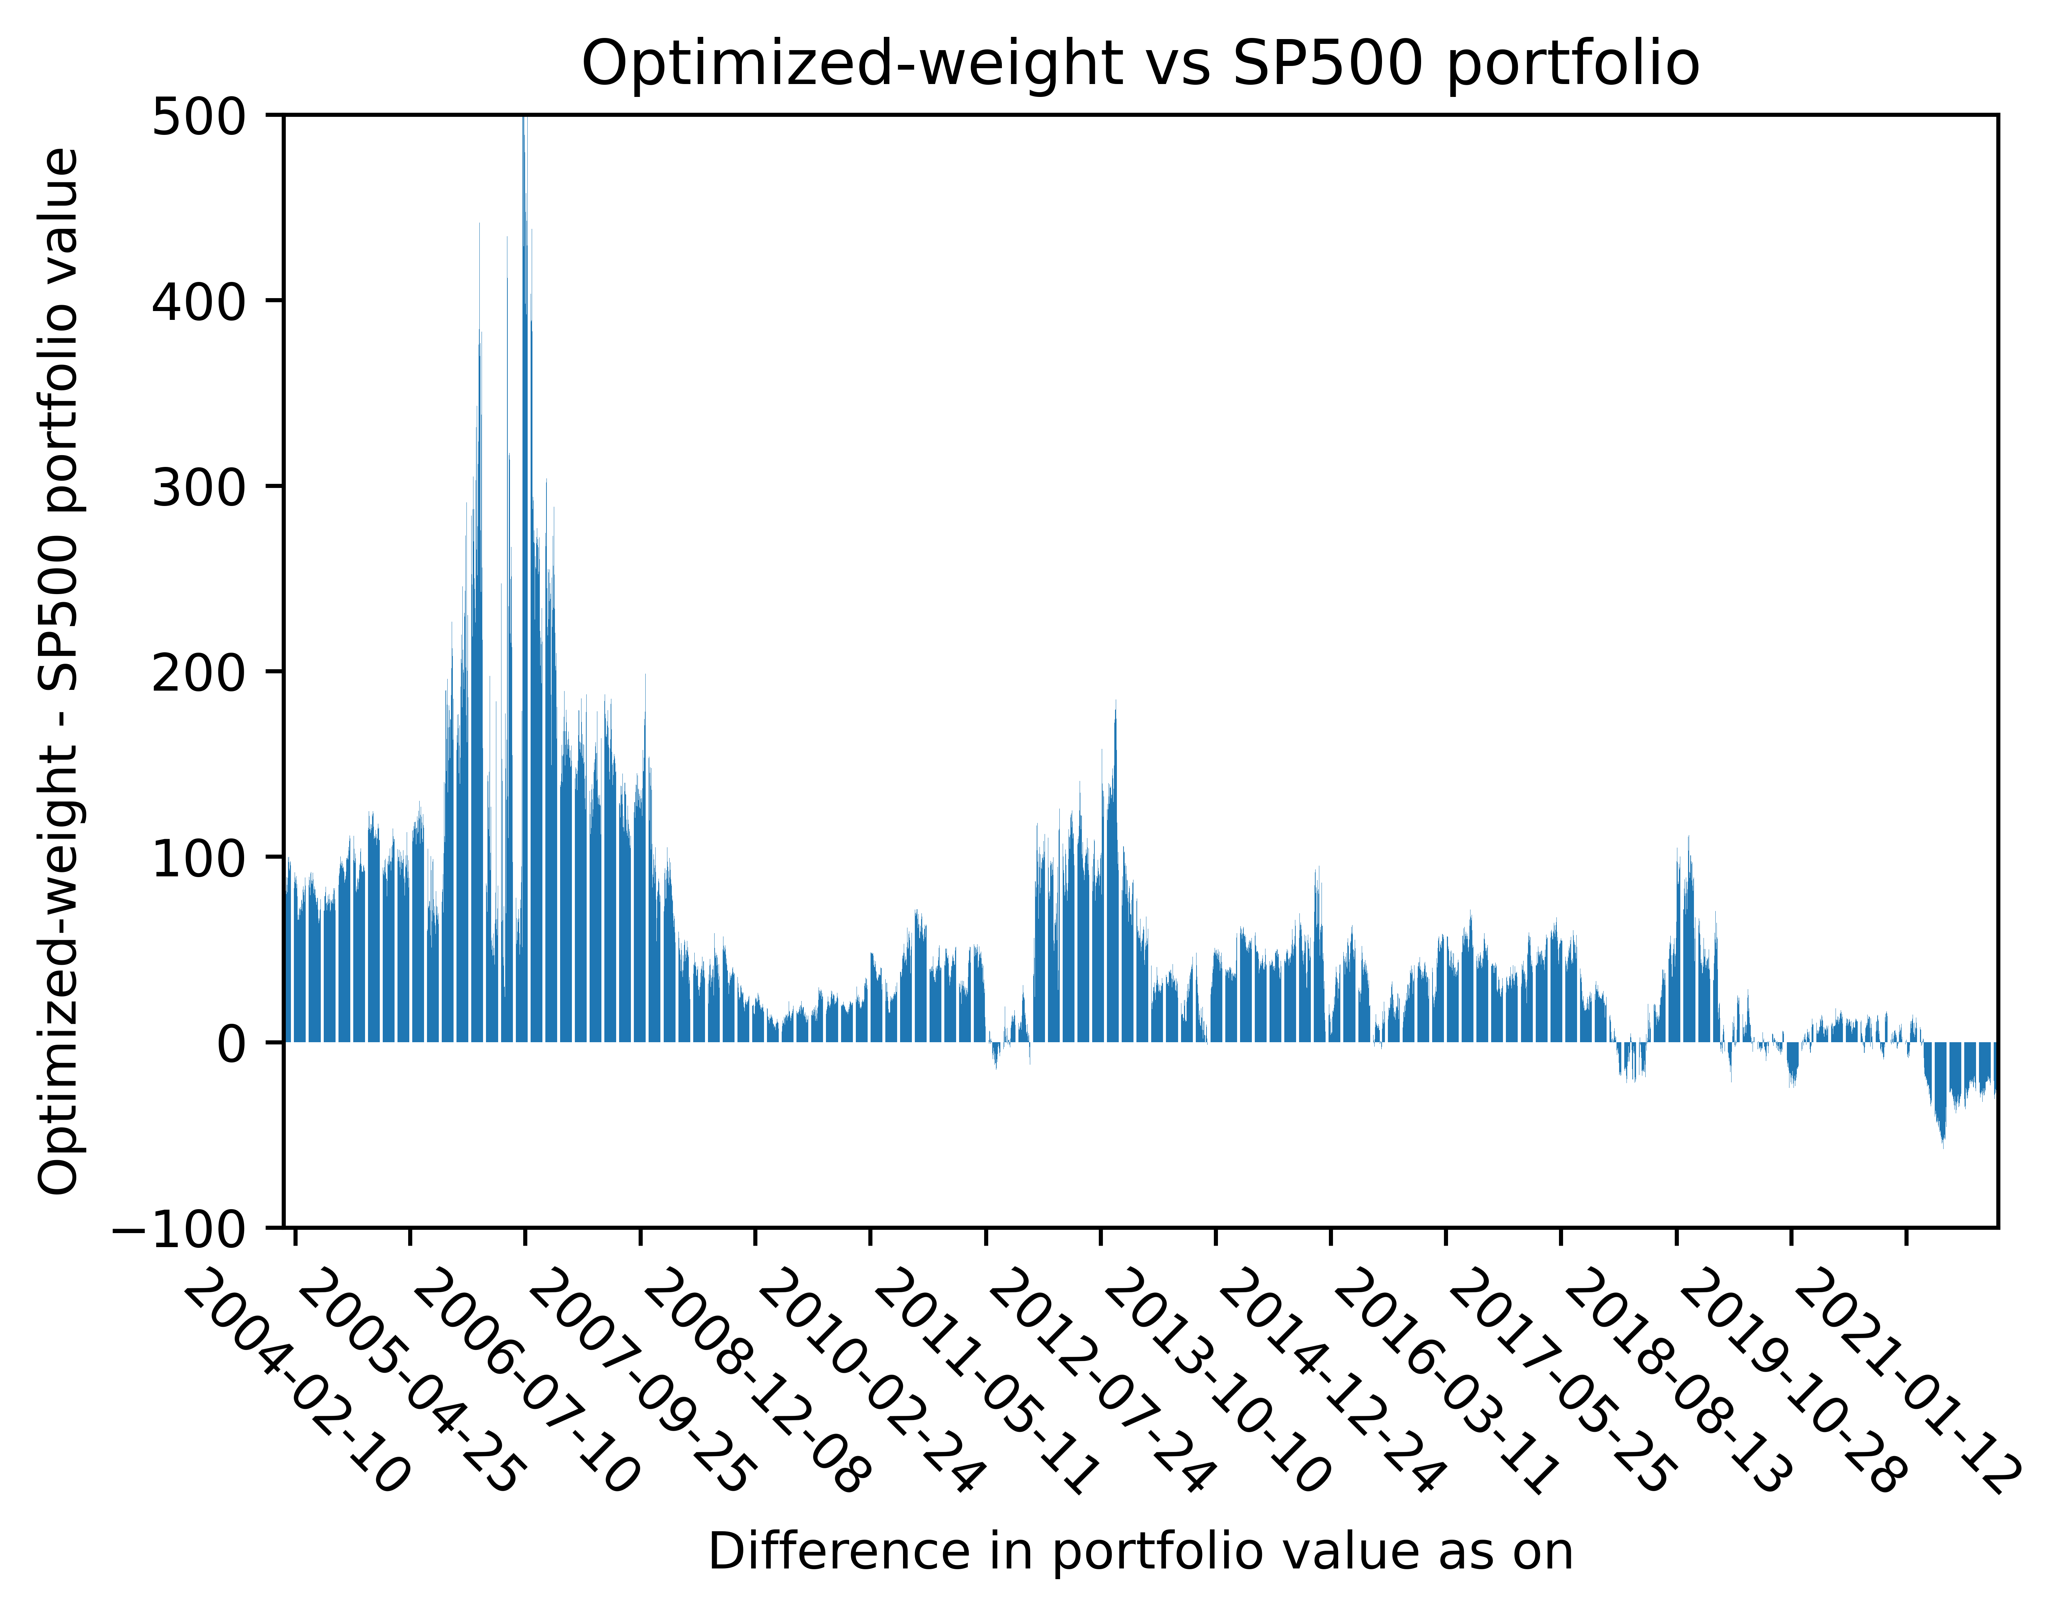
Back-test; Optimized vs SP500 portfolio
Metric (1 year) | Optimal Weight Portfolio | SP500
Average Portfolio Return | 18.28% | 7.14%
Average Portfolio SD | 12.68% | 7.61%
Minimum Return | -12.88% | -16.92%
25th Percentile Return | 10.95% | 5.22%
Median Return | 16.57% | 8.48%
75th Percentile Return | 23.96% | 10.75%
Maximum Return | 93.82% | 22.00%
Metric (2 years, annualized) | Optimal Weight Portfolio | SP500
Average Portfolio Return | 14.04% | 5.56%
Average Portfolio SD | 10.14% | 6.04%
Minimum Return | -15.67% | -20.58%
25th Percentile Return | 8.38% | 3.92%
Median Return | 13.35% | 6.49%
75th Percentile Return | 18.78% | 8.63%
Maximum Return | 77.85% | 20.85%
Holding period = 750 trading days, Total number of portfolio return series generated = 4535
Data from Dec 28 2000 to Dec 29 2021

Slide 36
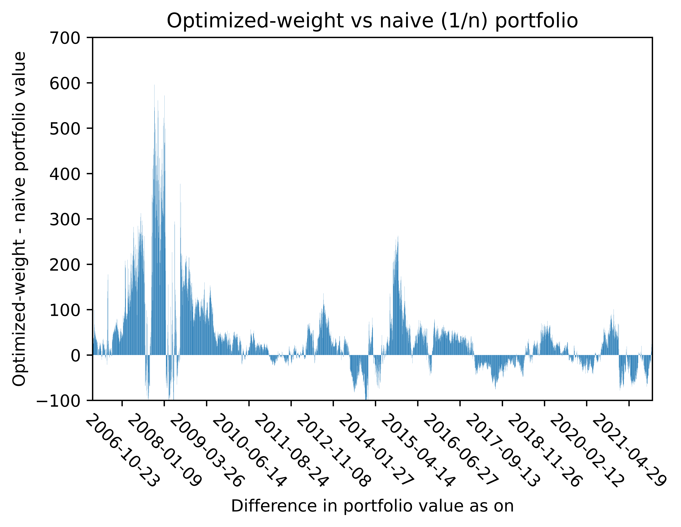
Back-test; Optimized vs naïve (1/n) portfolio
Metric (1 year) | Optimal Weight Portfolio | Naïve Portfolio
Average Portfolio Return | 18.07% | 14.77%
Average Portfolio SD | 15.31% | 12.33%
Minimum Return | 2.56% | 2.03%
25th Percentile Return | 11.92% | 10.60%
Median Return | 16.84% | 15.84%
75th Percentile Return | 21.39% | 18.57%
Maximum Return | 55.82% | 26.65%
Metric (2 years, annualized) | Optimal Weight Portfolio | Naïve Portfolio
Average Portfolio Return | 14.98% | 12.50%
Average Portfolio SD | 12.93% | 10.12%
Minimum Return | 0.05% | -1.25%
25th Percentile Return | 9.83% | 10.04%
Median Return | 14.04% | 13.06%
75th Percentile Return | 19.08% | 16.79%
Maximum Return | 47.56% | 22.10%
Holding period = 1250 trading days, Total number of portfolio return series generated = 4035
Data from Dec 28 2000 to Dec 29 2021

Slide 37
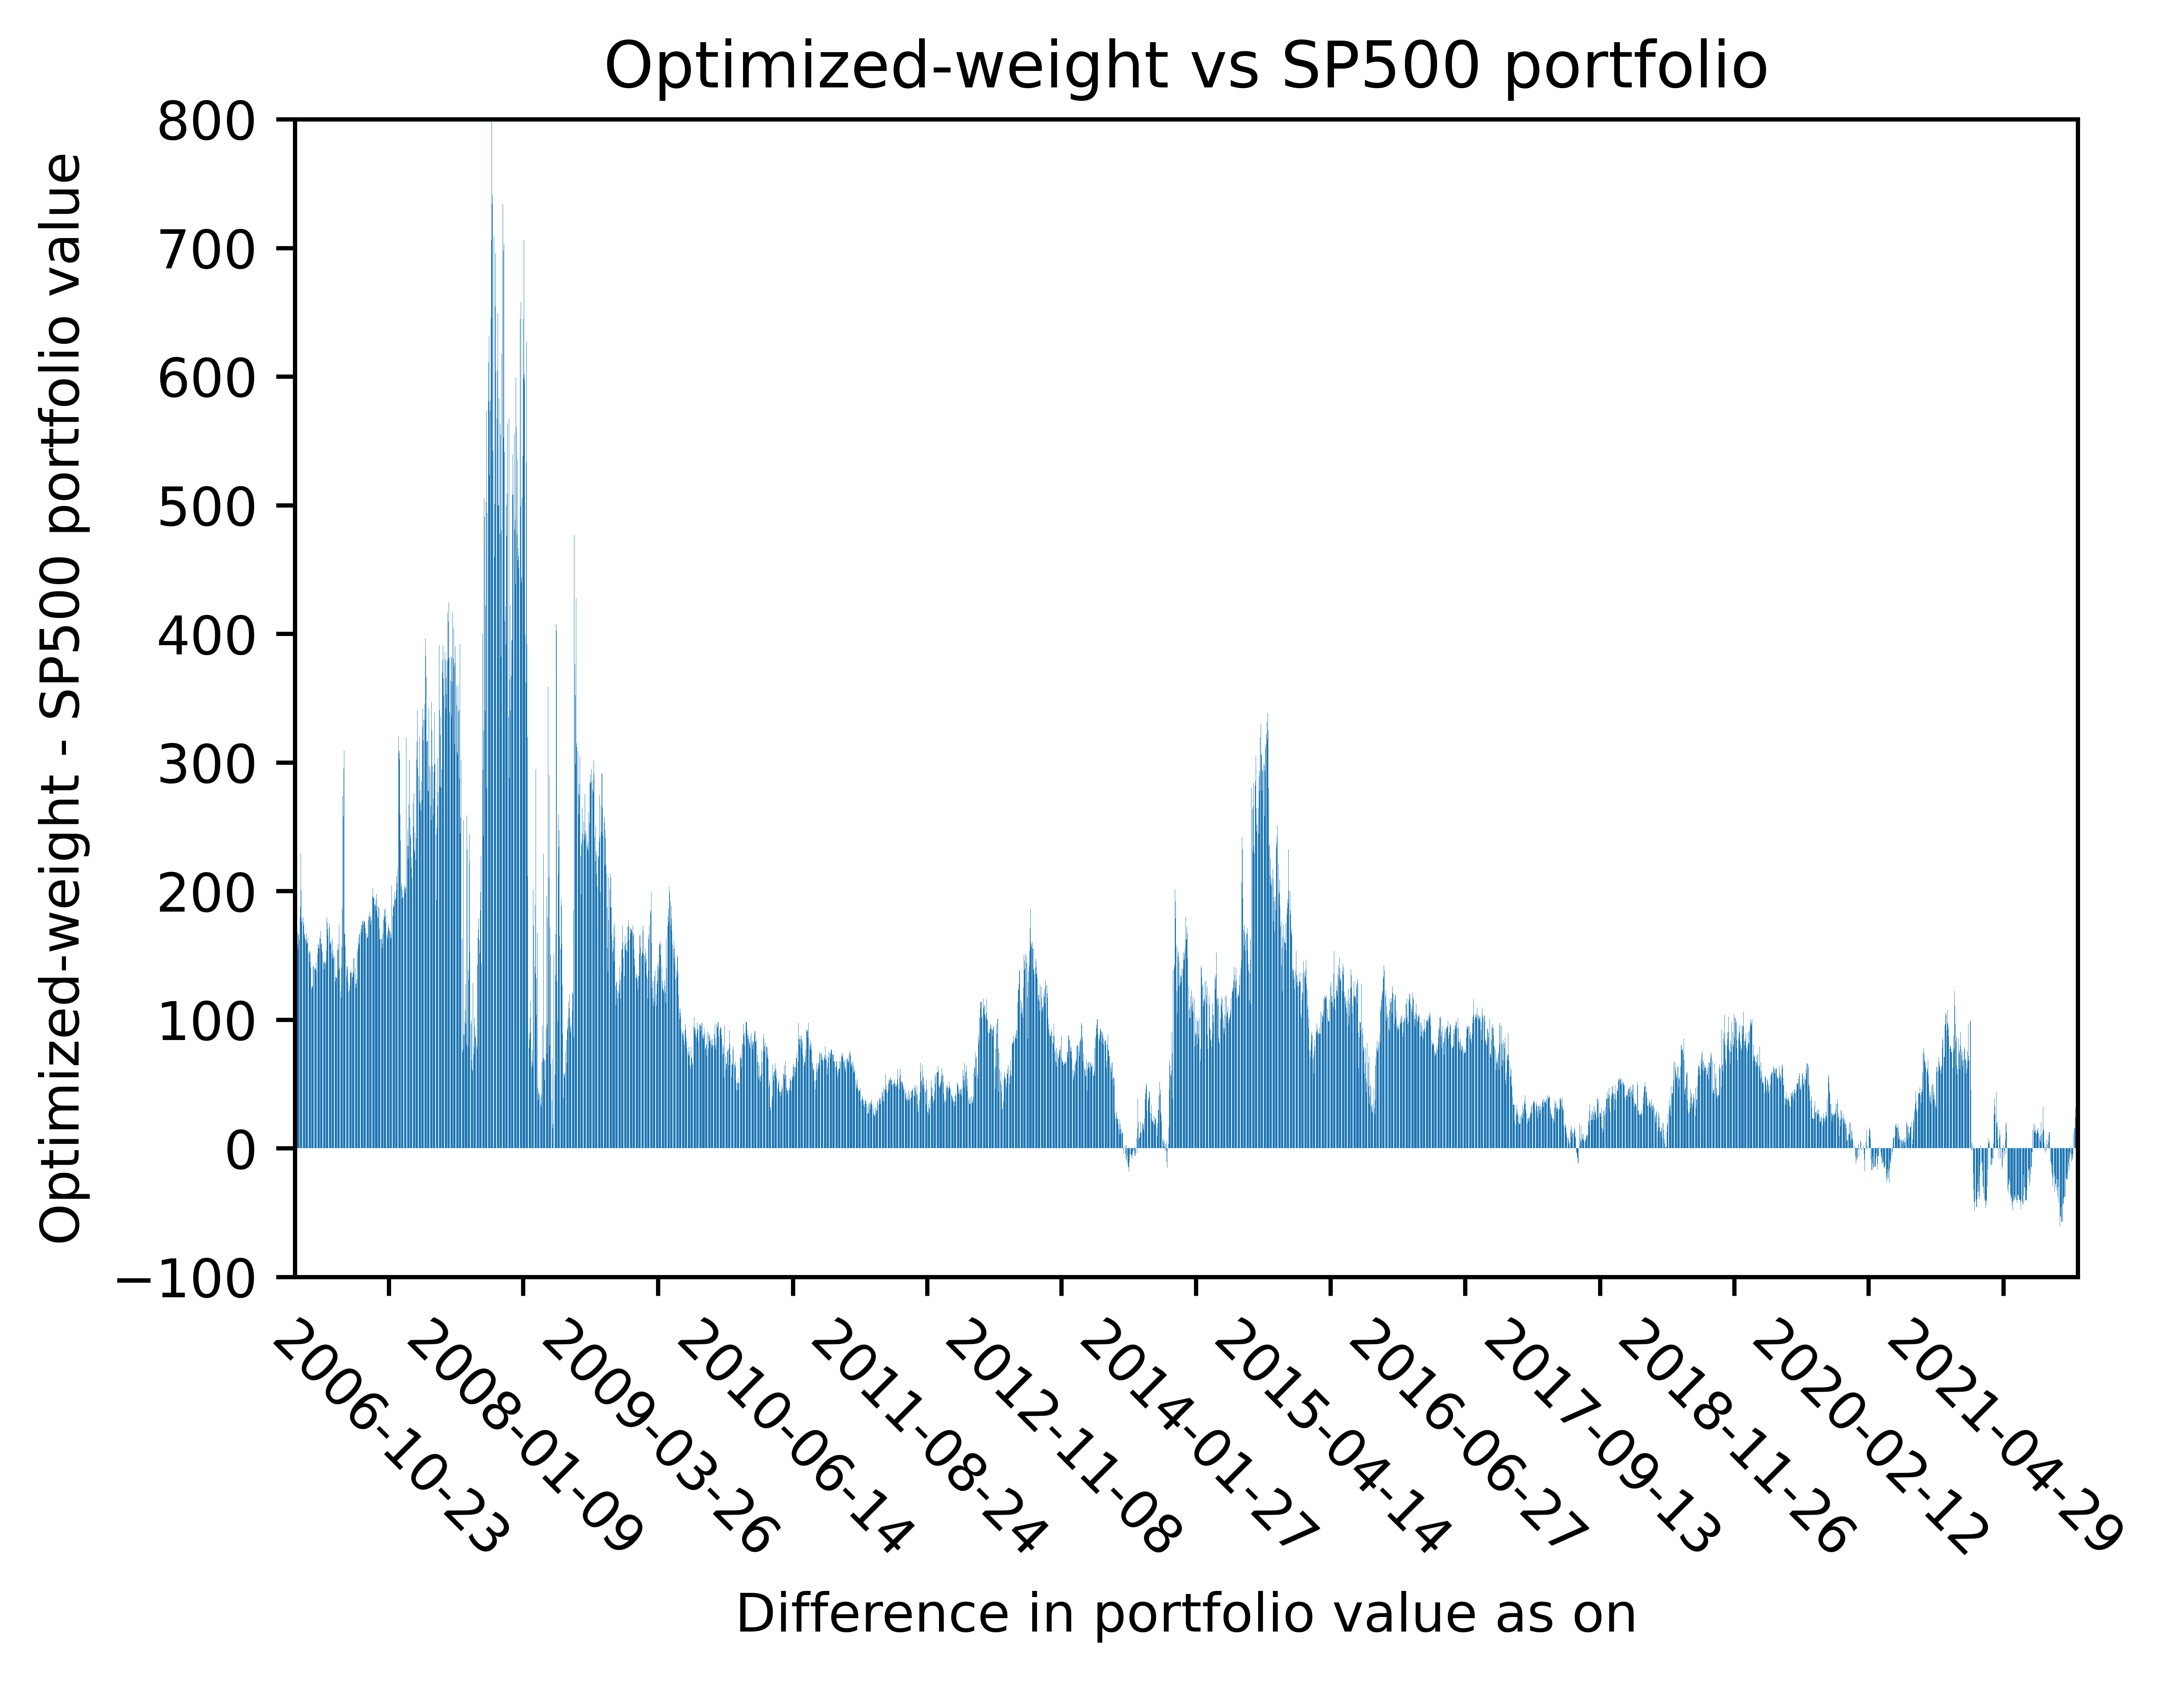
Back-test; Optimized vs SP500 portfolio
Metric (1 year) | Optimal Weight Portfolio | SP500
Average Portfolio Return | 18.07% | 7.39%
Average Portfolio SD | 15.31% | 9.41%
Minimum Return | 2.56% | -6.83%
25th Percentile Return | 11.92% | 2.86%
Median Return | 16.84% | 9.08%
75th Percentile Return | 21.39% | 11.06%
Maximum Return | 55.82% | 15.74%
Metric (2 years, annualized) | Optimal Weight Portfolio | SP500
Average Portfolio Return | 14.98% | 6.14%
Average Portfolio SD | 12.93% | 7.83%
Minimum Return | 0.05% | -8.81%
25th Percentile Return | 9.83% | 3.55%
Median Return | 14.04% | 7.93%
75th Percentile Return | 19.08% | 9.50%
Maximum Return | 47.56% | 12.67%
Holding period = 1250 trading days, Total number of portfolio return series generated = 4035
Data from Dec 28 2000 to Dec 29 2021

Slide 38
Conclusion
We present empirical results comparing the performance of the MAD model with a naïve (equal-weighted) portfolio as well as the SP500 Index.
The MAD model outperforms the SP500 Index across the 3 holding periods considered – 500, 750 and 1250 trading days (~2, 3, 5 years).
Importantly, using MAD as a risk measure improves worst-case-outcomes (as measured by minimum return) for the investment portfolio when compared to both the naïve portfolio and SP500 Index across the 3 holding periods considered.
The MAD-optimized portfolio also outperforms both the naïve portfolio and SP500 Index on a rolling return basis.

Slide 39
Conclusion
Portfolios optimized in-sample using the traditional mean-variance framework often underperform naïve portfolios out-of-sample. The instability can be traced to noise in input variables and signal structure that magnifies the estimation error of input variables¹.
To tackle these issues, many techniques such as the denoising of covariance matrices and other regularization methods have been used.
However, the MAD model does not require the calculation of a covariance matrix. While the model did not out-right (across all simulated portfolios) outperform the naïve portfolio – the advantages of the method in terms of performance (on-average) and computational efficiency (particularly valuable for large portfolios) make it a desirable alternative to the traditional mean-variance framework.
1. López de Prado, Marcos and López de Prado, Marcos, A Robust Estimator of the Efficient Frontier (October 15, 2016). Available at SSRN: https://ssrn.com/abstract=3469961 or http://dx.doi.org/10.2139/ssrn.3469961

Slide 40
Conclusion – future work
The relatively simple model may be expanded to include various constraints such as Asset exposure limits, sector limits, factor exposures and others.
The framework may also be expanded to build optimal portfolios consisting of varying asset classes (we only consider equities in our empirical work).
Leveraging the optimization framework to take a measured exposure to novel asset classes such as Cryptocurrencies may also prove valuable to investors and could be packaged as a Crypto-ETF or rule-based cryptocurrency fund.
Alternative risk measures, such as CVaR may also be considered when calculating optimal portfolio weights – though this makes the exercise much more computationally intensive.

Slide 41
References
Hiroshi Konno and Hiroaki Yamazaki. Mean-absolute deviation portfolio optimization model and its applications to Tokyo stock market. Management Science, 37(5):519–531, 1991
Renata Mansini, W. Ogryczak, and M.Grazia Speranza. Twenty years of linear programming based portfolio optimization. European Journal of Operational Research, 234:518–535, 04 2014
Renata Mansini, W. Ogryczak, and M.Grazia Speranza. Linear Models for Portfolio Optimization, pages 19–45. Springer, 01 2015
R. Tyrrell Rockafellar and Stanislav Uryasev. Optimization of conditional value-at-risk. Journal of Risk, 2:21–41, 2000
https://en.wikipedia.org/
https://docs.scipy.org/doc/scipy/
https://finance.yahoo.com/

Slide 42
References
https://riskfolio-lib.readthedocs.io/en/latest/
https://matplotlib.org/3.5.1/index.html
https://pandasguide.readthedocs.io/en/latest/
https://pypi.org/project/yfinance/

Slide 43
Methods
All computations and diagrams are executed using Python
Packages used: yfinance (data import from Yahoo), Pandas (data manipulation), NumPy, Matploitlib (for plots), SciPy, riskfolio
Data:
Daily close price of 277 stocks from the SP500
Start date: January 1 2000
End date : January 1 2022
Data points = 5536 (5535 after calculating log daily return, about 22 years)

Slide 44
Thank you!

